Slide 1
Cross-Linguistic Analysis for Depression Detection
Author: Dinică Mircea

Slide 2
Depression
Disinterest in routine activities
Sleep Disturbances
Inability to feel pleasure
Thoughts of suicide
Affecting over 300 million individuals worldwide

Slide 3
Proposed prevention
AI model that can be included in applications
Input: text
Output: is depression or not
Applicable for any language

Slide 4
Implementation Details
Dataset with 7650 entries
Googletrans Python Library
LIWC processing tool
Random Forrest Classifier
Classification Metrics, Confusion Matrix, AUC, Feature Importance

Slide 5
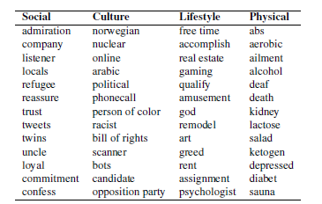
LIWC dictionary categories examples

